Slide 1
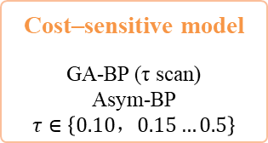


1. Data preparation
2. Baseline prediction models
3. Underestimation risk control
4. Multi-metric evaluation
5. Interpretation and decision
44 OHL projects
8 benchmark models
Asymmetric GA-BP exploration
τ-parameter sensitivity analysis and performance evaluation
LOO-CV
Multi-metric evaluation
Accuracy metrics
Interpretation & decision
Ridge
SVR
RMSE
MAE
SHAP analysis
Global feature importance Local interpretation
Heavy-tailed data
RF
GBT
MAPE
R²
Conclusion:
Asymmetric GA-BP exploration did not show a stable advantage
Key driver identification
Identify the key factors with the greatest impact on cost and support engineering decisions
UR
MUM
XG
Boost
Light
GBM
15 input variables
CU
CWUS
BP-NN
PSO-BP
Exogenous underestimation control methods
Risk–accuracy trade-off
Compare the performance of different methods under different risk preferences and identify the optimal solution
Upper envelope ensemble
$${\hat{y}}_{max}(x)=maxf_{k}\left(x\right)$$
Integrated analysis
Data preprocessing
Missing value handling
Z-score normalization
Feature harmonization
Cost–sensitive model
GA-BP (τ scan)
Asym-BP
$$τ∈\left\{0.10，0.15…0.5\right\}$$
Pareto analysis
Engineering decision support
Residual-quantile adjustment
$${\hat{y}}_{safe}\left(x\right)=f\left(x\right)+s_{q}$$

